Slide 1
Module 3 Collections and Database Programming using JDBC

Slide 2
Topics
Collection - The Collection Framework:
Collections of Objects, Collection Types, Sets, Sequence, Map, Understanding Hashing, Use of Array List & Vector, Comparable and Comparator Interfaces.
Database Programming using JDBC:
Introduction to JDBC, JDBC Drivers & Architecture, CRUD operation Using JDBC, Connecting to non-conventional Databases.

Slide 3
Collection Framework
provides an architecture to store and manipulate the group of objects.
achieve all the operations that you perform on a data such as searching, sorting, insertion, manipulation, and deletion.
Java Collection means a single unit of objects. Java Collection framework provides many interfaces (Set, List, Queue, Deque) and classes (ArrayList, Vector, LinkedList, PriorityQueue, HashSet, LinkedHashSet, TreeSet).

Slide 4
What Is a Collection?
Collection (sometimes called a container) is simply an object that groups multiple elements into a single unit.
Usage:
to store and retrieve data
to manipulate data
to transmit data from one method to another
Collections typically represent data items that form a natural group like:
a poker hand (a collection of cards)
a mail folder (a collection of letters)
a telephone directory (a collection of name-to-phone-number mappings)

Slide 5
Collection Framework 1
A collections framework is a unified architecture for representing and manipulating collections.
All collections frameworks contain three things:
Interfaces
abstract data types representing collections.
Interfaces allow collections to be manipulated independently of the details of their representation.

Slide 6
Collection Framework 2
Implementations
concrete implementations of the collection interfaces.
In essence, these are reusable data structures.
Algorithms
methods that perform useful computations like searching and sorting, on objects that implement collection interfaces.
they are polymorphic because the same method can be used on many different implementations of the appropriate collections interface.
In essence, they are reusable functionality.

Slide 7
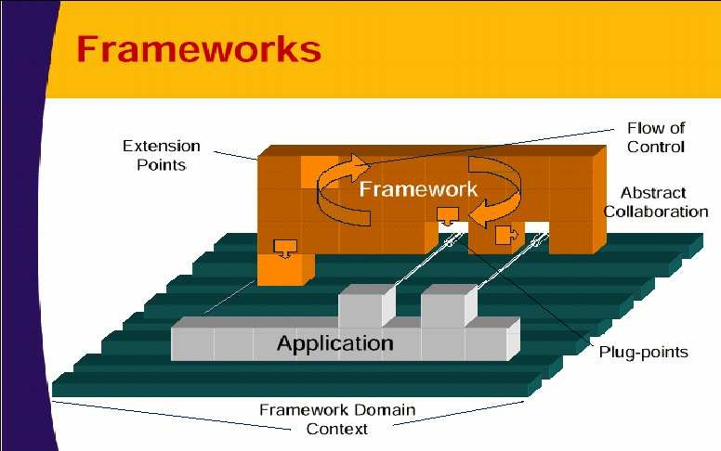
Collection Framework 3

Slide 8
Benefits 1
Collection Framework offers the following benefits:
It reduces programming effort
Powerful data structures and algorithms
It increases program speed and quality
High quality implementations
Fine tuning by switching implementations
It allows interoperability among unrelated APIs
Passing objects around from one API to another

Slide 9
Benefits 2
It reduces the effort to learn and use new APIs
Uniformity of the framework
APIs of applications
It reduces effort to design new APIs
It fosters software reuse
New data structures and algorithms

Slide 10
Core Collection Interfaces 1
These are interfaces used to manipulate collections, and pass them from one method to another.
Purpose:
To allow collections to be manipulated independently of the details of their representation.
Note:
They are the heart and soul of the collections framework.
When you understand how to use these interfaces, you know most of what there is to know about the framework.

Slide 11
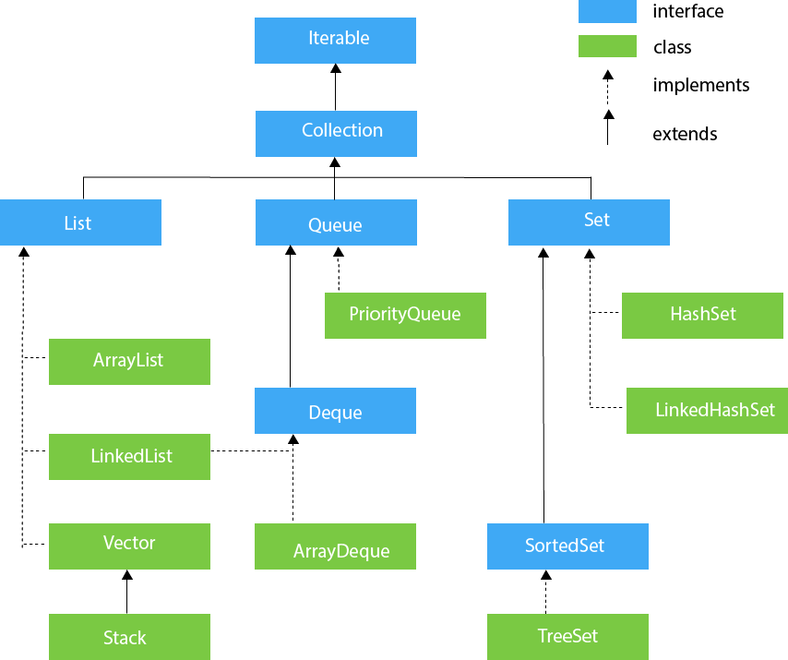
Hierarchy of Collection Framework
The java.util package contains all the classes and interfaces for the Collection framework.

Slide 12
Methods of Collection interface
No. | Method | Description
1 | public boolean add(E e) | It is used to insert an element in this collection.
2 | public boolean addAll(Collection<? extends E> c) | It is used to insert the specified collection elements in the invoking collection.
3 | public boolean remove(Object element) | It is used to delete an element from the collection.
4 | public boolean removeAll(Collection<?> c) | It is used to delete all the elements of the specified collection from the invoking collection.
5 | default boolean removeIf(Predicate<? super E> filter) | It is used to delete all the elements of the collection that satisfy the specified predicate.
6 | public boolean retainAll(Collection<?> c) | It is used to delete all the elements of invoking collection except the specified collection.

Slide 13
Methods of Collection interface (contd...)
No. | Method | Description
7 | public int size() | It returns the total number of elements in the collection.
8 | public void clear() | It removes the total number of elements from the collection.
9 | public boolean contains(Object element) | It is used to search an element.
10 | public boolean containsAll(Collection<?> c) | It is used to search the specified collection in the collection.
11 | public Iterator iterator() | It returns an iterator.
12 | public Object[] toArray() | It converts collection into array.
13 | public <T> T[] toArray(T[] a) | It converts collection into array. Here, the runtime type of the returned array is that of the specified array.
14 | public boolean isEmpty() | It checks if collection is empty.

Slide 14
Iterable Interface
The Iterable interface is the root interface for all the collection classes. The Collection interface extends the Iterable interface and therefore all the subclasses of Collection interface also implement the Iterable interface.
It contains only one abstract method. i.e.,
Iterator<T> iterator()
It returns the iterator over the elements of type T.

Slide 15
Iterator interface
Iterator interface provides the facility of iterating the elements in a forward direction only.
No. | Method | Description
1 | public boolean hasNext() | It returns true if the iterator has more elements, otherwise it returns false.
2 | public Object next() | It returns the element and moves the cursor pointer to the next element.
3 | public void remove() | It removes the last elements returned by an iterator.

Slide 16
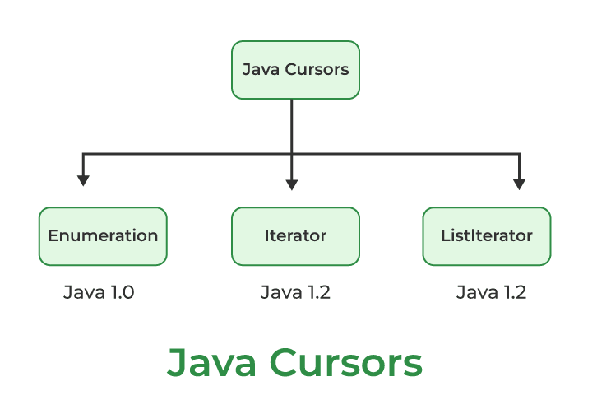
Java Cursor
used to iterate or traverse or retrieve a Collection or Stream object’s elements one by one.
Access collection by
Using iterator() Method
Using forEach() Method
Using listIterator() Method

Slide 17
Collection Interface
The Collection interface is the interface which is implemented by all the classes in the collection framework. It declares the methods that every collection will have. In other words, we can say that the Collection interface builds the foundation on which the collection framework depends.
Some of the methods of Collection interface are Boolean add ( Object obj), Boolean addAll ( Collection c), void clear(), etc. which are implemented by all the subclasses of Collection interface.

Slide 18
List Interface
List interface is the child interface of Collection interface. It inhibits a list type data structure in which we can store the ordered collection of objects. It can have duplicate values.
List interface is implemented by the classes ArrayList, LinkedList, Vector, and Stack.
To instantiate the List interface, we must use :
List <data-type> list1= new ArrayList();
List <data-type> list2 = new LinkedList();
List <data-type> list3 = new Vector();
List <data-type> list4 = new Stack();
There are various methods in List interface that can be used to insert, delete, and access the elements from the list.

Slide 19
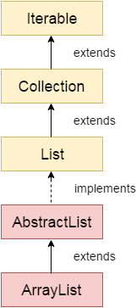
ArrayList
The ArrayList class implements the List interface. It uses a dynamic array to store the duplicate element of different data types. The ArrayList class maintains the insertion order and is non-synchronized. The elements stored in the ArrayList class can be randomly accessed.
It is like an array, but there is no size limit. We can add or remove elements anytime. So, it is much more flexible than the traditional array. It is found in the java.util package.
It inherits the AbstractList class and implements List interface.

Slide 20
In ArrayList, manipulation is a little bit slower than the LinkedList in Java, because a lot of shifting needs to occur if any element is removed from the array list.
We can not create an array list of the primitive types, such as int, float, char, etc. It is required to use the required wrapper class in such cases.

Slide 21
Example
import java.util.*;
public class ArrayListExample2{
public static void main(String args[]){
ArrayList<String> list=new ArrayList<String>();//Creating arraylist
list.add("Mango");//Adding object in arraylist
list.add("Apple");
list.add("Banana");
list.add("Grapes");
//Traversing list through an Iterator
Iterator itr=list.iterator();//getting the Iterator
while(itr.hasNext())//check if iterator has the elements System.out.println(itr.next());//printing the element and move to next
}
}

Slide 22
Example
System.out.println("Sorting numbers...");
//Creating a list of numbers
List<Integer> list2=new ArrayList<Integer>();
list2.add(21);
list2.add(11);
list2.add(51);
list2.add(1);
//Sorting the list
Collections.sort(list2);
//Traversing list through for-each loop
for(Integer number:list2)
System.out.println(number);
}
}
import java.util.*;
class SortArrayList{
public static void main(String args[]){
//Creating a list of fruits
List<String> list1=new ArrayList<String>();
list1.add("Mango");
list1.add("Apple");
list1.add("Banana");
list1.add("Grapes");
//Sorting the list
Collections.sort(list1);
//Traversing list through for-each loop
for(String fruit:list1)
System.out.println(fruit);

Slide 23
Example: User-defined class objects in Java ArrayList
import java.util.*;
class ArrayList5{
public static void main(String args[]){
//Creating user-defined class objects
Student s1=new Student(101,"Sonoo",23);
Student s2=new Student(102,"Ravi",21);
Student s3=new Student(103,“Manju",25);
//creating arraylist
List<Student> l=new ArrayList<Student>(); or
l.add(s1);//adding Student class object
l.add(s2);
l.add(s3);
//Getting Iterator
ListIterator itr=l.listIterator();
//traversing elements of ArrayList object
while(itr.hasNext()){
Student st=(Student)itr.next();
System.out.println(st.rollno+" "+st.name+" "+st.age);
}
}
}
class Student{
int rollno;
String name;
int age;
Student(int rollno,String name,int age){
this.rollno=rollno;
this.name=name;
this.age=age;
}
}

Slide 24
Vector
Vector is like the dynamic array which can grow or shrink its size. Unlike array, we can store n-number of elements in it as there is no size limit.
It is similar to the ArrayList, but with two differences-
Vector is synchronized.
Java Vector contains many legacy methods that are not the part of a collections framework.

Slide 25
Difference between ArrayList and Vector
ArrayList | Vector
1) ArrayList is not synchronized. | Vector is synchronized.
2) ArrayList is not a legacy class. It is introduced in JDK 1.2. | Vector is a legacy class.
3) ArrayList is fast because it is non-synchronized. | Vector is slow because it is synchronized, i.e., in a multithreading environment, it holds the other threads in runnable or non-runnable state until current thread releases the lock of the object.
4) ArrayList uses the Iterator interface to traverse the elements. | A Vector can use the Iterator interface

Slide 26
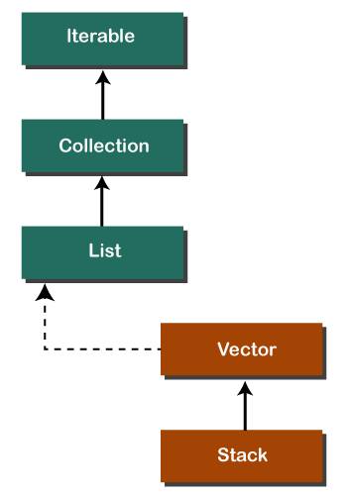
Stack
In Java, Stack is a class that falls under the Collection framework that extends the Vector class. It also implements interfaces List, Collection, Iterable, Cloneable, Serializable. It represents the LIFO stack of objects. Before using the Stack class, we must import the java.util package.

Slide 27
Example
import java.util.Stack;
class Main { public static void main(String[] args) {
Stack<String> animals= new Stack<String>();
animals.push("Dog");
animals.push("Horse");
animals.push("Cat");
System.out.println("Initial Stack: " + animals);
String element = animals.pop();
System.out.println("Removed Element: " + element);
}
}

Slide 28
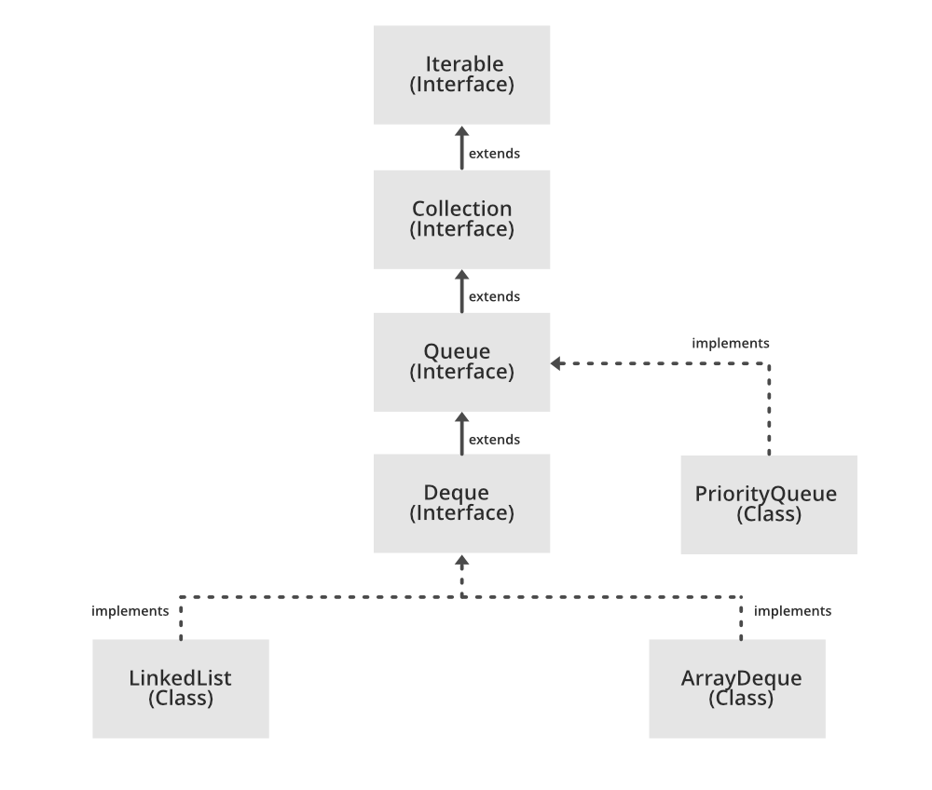
Queue
Queue is used to hold the elements about to be processed in FIFO(First In First Out) order. It is an ordered list of objects with its use limited to inserting elements at the end of the list and deleting elements from the start of the list, (i.e.), it follows the FIFO or the First-In-First-Out principle.

Slide 29
Example
// print the updated queue
System.out.println("Queue after removal: " + queue);
// add another element to the queue
queue.add("date");
// peek at the element at the front of the queue
String peeked = queue.peek();
System.out.println("Peeked element: " + peeked);
// print the updated queue
System.out.println("Queue after peek: " + queue);
}
}
import java.util.LinkedList;
import java.util.Queue;
public class QueueExample {
public static void main(String[] args) {
Queue<String> queue = new LinkedList<>();
// add elements to the queue
queue.add("apple");
queue.add("banana");
queue.add("cherry");
// print the queue
System.out.println("Queue: " + queue);
// remove the element at the front of the queue
String front = queue.remove();
System.out.println("Removed element: " + front);

Slide 30
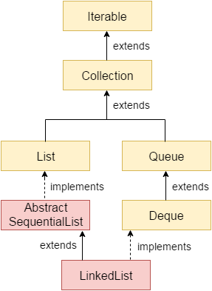
Java LinkedList class
Java LinkedList class uses a doubly linked list to store the elements. It provides a linked-list data structure. It inherits the AbstractList class and implements List and Deque interfaces.
The important points about Java LinkedList are:
Java LinkedList class can contain duplicate elements.
Java LinkedList class maintains insertion order.
Java LinkedList class is non synchronized.
In Java LinkedList class, manipulation is fast because no shifting needs to occur.
Java LinkedList class can be used as a list, stack or queue.

Slide 31
Example
import java.util.*;
public class LinkedList2{
public static void main(String args[]){
LinkedList<String> ll=new LinkedList<String>();
System.out.println("Initial list of elements: "+ll);
ll.add("Ravi");
ll.add("Vijay");
ll.add("Ajay");
System.out.println("After invoking add(E e) method: "+ll);
//Adding an element at the specific position
ll.add(1, "Gaurav");
System.out.println("After invoking add(int index, E element) method: "+ll);
LinkedList<String> ll2=new LinkedList<String>();
ll2.add("Sonoo");
ll2.add("Hanumat");
//Adding second list elements to the first list
ll.addAll(ll2);
System.out.println("After invoking addAll(Collection<? extends E> c) method: "+ll);
LinkedList<String> ll3=new LinkedList<String>();
ll3.add("John");
ll3.add("Rahul");
//Adding second list elements to the first list at specific position
ll.addAll(1, ll3);
System.out.println("After invoking addAll(int index, Collection<? extends E> c) method: "+ll);
//Adding an element at the first position
ll.addFirst("Lokesh");
System.out.println("After invoking addFirst(E e) method: "+ll);
//Adding an element at the last position
ll.addLast("Harsh");
System.out.println("After invoking addLast(E e) method: "+ll);
ll.remove("Vijay");
System.out.println("After invoking remove(object) method: "+ll);
//Removing element on the basis of specific position
ll.remove(0);
System.out.println("After invoking remove(index) method: "+ll);
LinkedList<String> ll2=new LinkedList<String>();
ll2.add("Ravi");
ll2.add("Hanumat");
// Adding new elements to arraylist
ll.addAll(ll2);
System.out.println("Updated list : "+ll);
//Removing all the new elements from arraylist
ll.removeAll(ll2);
System.out.println("After invoking removeAll() method: "+ll);
//Removing first element from the list
ll.removeFirst();
System.out.println("After invoking removeFirst() method: "+ll);
//Removing first element from the list
ll.removeLast();
System.out.println("After invoking removeLast() method: "+ll);
//Removing first occurrence of element from the list
ll.removeFirstOccurrence("Gaurav");
System.out.println("After invoking removeFirstOccurrence() method: "+ll);
//Removing last occurrence of element from the list
ll.removeLastOccurrence("Harsh");
System.out.println("After invoking removeLastOccurrence() method: "+ll);
//Removing all the elements available in the list
ll.clear();
System.out.println("After invoking clear() method: "+ll);
}
}

Slide 32
Example
import java.util.*;
public class LinkedList4{
public static void main(String args[]){
LinkedList<String> ll=new LinkedList<String>();
ll.add("Ravi");
ll.add("Vijay");
ll.add("Ajay");
//Traversing the list of elements in reverse order
Iterator i=ll.descendingIterator();
while(i.hasNext())
System.out.println(i.next());
}
}

Slide 33
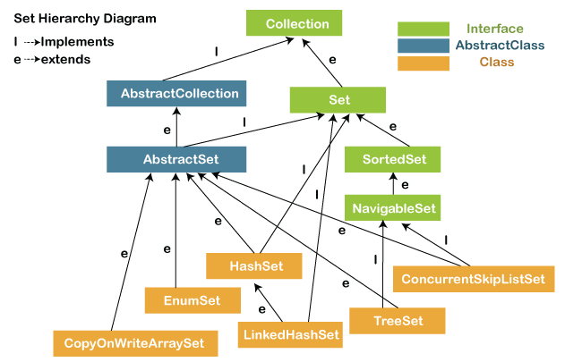
Set
The set is an interface available in the java.util package. The set interface extends the Collection interface. An unordered collection or list in which duplicates are not allowed is referred to as a collection interface.
The set interface is used to create the mathematical set. The set interface use collection interface's methods to avoid the insertion of the same elements.
SortedSet and NavigableSet are two interfaces that extend the set implementation.

Slide 34
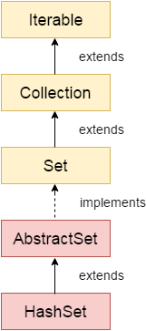
HashSet
Java HashSet class is used to create a collection that uses a hash table for storage. It inherits the AbstractSet class and implements Set interface.
The important points about Java HashSet class are:
HashSet stores the elements by using a mechanism called hashing.
HashSet contains unique elements only.
HashSet allows null value.
HashSet class is non synchronized.
HashSet doesn't maintain the insertion order. Here, elements are inserted on the basis of their hashcode.
HashSet is the best approach for search operations.
The initial default capacity of HashSet is 16, and the load factor is 0.75.

Slide 35
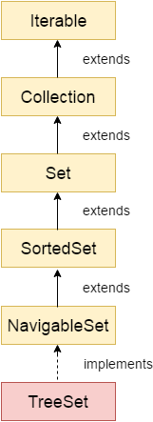
TreeSet
Java TreeSet class implements the Set interface that uses a tree for storage. It inherits AbstractSet class and implements the NavigableSet interface. The objects of the TreeSet class are stored in ascending order.
The important points about the Java TreeSet class are:
Java TreeSet class contains unique elements only like HashSet.
Java TreeSet class access and retrieval times are quiet fast.
Java TreeSet class doesn't allow null element.
Java TreeSet class is non synchronized.
Java TreeSet class maintains ascending order.
Java TreeSet class contains unique elements only like HashSet.
Java TreeSet class access and retrieval times are quite fast.
Java TreeSet class doesn't allow null elements.
Java TreeSet class is non-synchronized.
Java TreeSet class maintains ascending order.
The TreeSet can only allow those generic types that are comparable. For example The Comparable interface is being implemented by the StringBuffer class.
Internal Working of The TreeSet Class

Slide 36
Example
import java.util.*;
class TreeSet1{
public static void main(String args[]){
//Creating and adding elements
TreeSet<String> al=new TreeSet<String>();
al.add("Ravi");
al.add("Vijay");
al.add("Ravi");
al.add("Ajay");
//Traversing elements
Iterator<String> itr=al.iterator();
while(itr.hasNext()){
System.out.println(itr.next());
}
}
}

Slide 37
Difference between List and Set
A list can contain duplicate elements whereas Set contains unique elements only.
import java.util.*;
public class SetOperations {
public static void main(String args[]) {
Integer[] A = {22, 45,33, 66, 55, 34, 77};
Integer[] B = {33, 2, 83, 45, 3, 12, 55};
Set<Integer> set1 = new HashSet<Integer>();
set1.addAll(Arrays.asList(A));
Set<Integer> set2 = new HashSet<Integer>();
set2.addAll(Arrays.asList(B));
// Finding Union of set1 and set2
Set<Integer> set3= new HashSet<Integer>(set1);
set3.addAll(set2);
System.out.print("Union of set1 and set2 is:");
System.out.println(set3);
// Finding Intersection of set1 and set2
Set<Integer> set4 = new HashSet<Integer>(set1);
set4.retainAll(set2);
System.out.print("Intersection of set1 and set2 is:");
System.out.println(set4);
// Finding Difference of set1 and set2
Set<Integer> set5= new HashSet<Integer>(set1);
set5.removeAll(set2);
System.out.print("Difference of set1 and set2 is:");
System.out.println(set5);
}
}

Slide 38
Map Interface
A map contains values on the basis of key, i.e. key and value pair. Each key and value pair is known as an entry. A Map contains unique keys.
A Map is useful if you have to search, update or delete elements on the basis of a key.
A Map doesn't allow duplicate keys, but you can have duplicate values. HashMap and LinkedHashMap allow null keys and values, but TreeMap doesn't allow any null key or value.

Slide 39
Java HashMap
Java HashMap class implements the Map interface which allows us to store key and value pair, where keys should be unique. If you try to insert the duplicate key, it will replace the element of the corresponding key. It is easy to perform operations using the key index like updation, deletion, etc. HashMap class is found in the java.util package.
HashMap in Java is like the legacy Hashtable class, but it is not synchronized. It allows us to store the null elements as well, but there should be only one null key. Since Java 5, it is denoted as HashMap<K,V>, where K stands for key and V for value. It inherits the AbstractMap class and implements the Map interface.

Slide 40
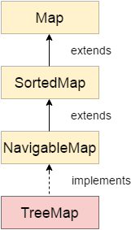
TreeMap
Java TreeMap class is a red-black tree based implementation. It provides an efficient means of storing key-value pairs in sorted order.
The important points about Java TreeMap class are:
Java TreeMap contains values based on the key. It implements the NavigableMap interface and extends AbstractMap class.
Java TreeMap contains only unique elements.
Java TreeMap cannot have a null key but can have multiple null values.
Java TreeMap is non synchronized.
Java TreeMap maintains ascending order.

Slide 41
Java Map Example: Non-Generic (Old Style)
//Non-generic
import java.util.*;
public class MapExample1 {
public static void main(String[] args) {
Map<Integer,String> map=new HashMap();
//Adding elements to map
map.put(1,"Amit");
map.put(5,"Rahul");
map.put(2,"Jai");
map.put(6,"Amit");
//Traversing Map
Set set=map.entrySet();//Converting to Set so that we can traverse
Iterator itr=set.iterator();
while(itr.hasNext()){
//Converting to Map.Entry so that we can get key and value separately
Map.Entry entry=(Map.Entry)itr.next();
System.out.println(entry.getKey()+" "+entry.getValue());
}
}
}

Slide 42
Java Map Example: Generic (New Style)
import java.util.*;
class MapExample2{
public static void main(String args[]){
Map<Integer,String> map=new HashMap<Integer,String>();
map.put(100,"Amit");
map.put(101,"Vijay");
map.put(102,"Rahul");
//Elements can traverse in any order
for(Map.Entry m:map.entrySet())
System.out.println(m.getKey()+" "+m.getValue());
}
}

Slide 43
Comparable interface
Java Comparable interface is used to order the objects of the user-defined class. This interface is found in java.lang package and contains only one method named compareTo(Object). It provides a single sorting sequence only,

Slide 44
Comparator interface
Java Comparator interface is used to order the objects of a user-defined class.
This interface is found in java.util package and contains 2 methods compare(Object obj1,Object obj2) and equals(Object element).
It provides multiple sorting sequences, i.e., you can sort the elements on the basis of any data member, for example, rollno, name, age or anything else.

Slide 45
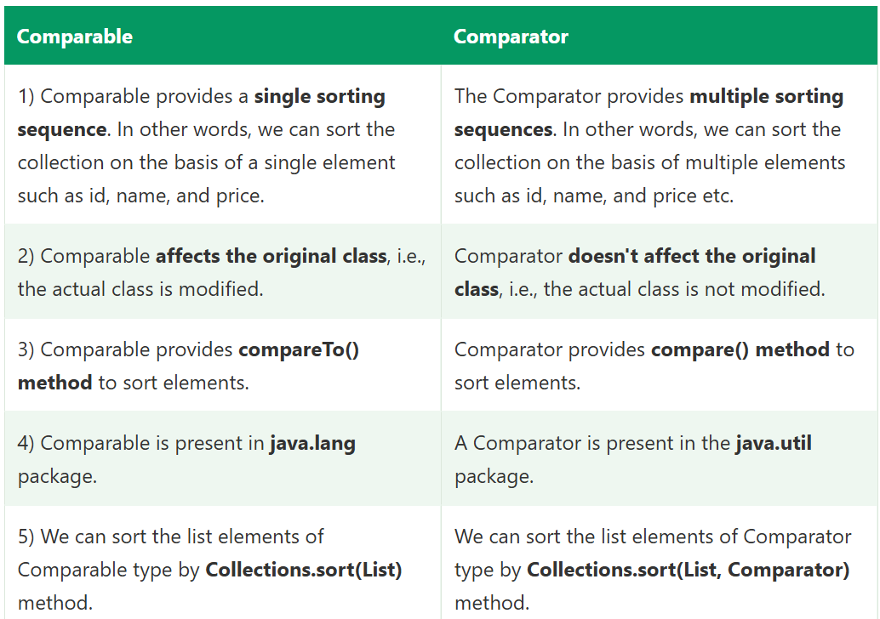
Comparable vs Comparator
Comparable & Comparator are interfaces which can be used to sort collection elements.

Slide 46
JDBC
JDBC stands for Java Database Connectivity. JDBC is a Java API to connect and execute the query with the database. It is a part of JavaSE (Java Standard Edition). JDBC API uses JDBC drivers to connect with the database.
There are four types of JDBC drivers:
JDBC-ODBC Bridge Driver,
Native Driver,
Network Protocol Driver, and
Thin Driver
use JDBC API to access tabular data stored in any relational database. By the help of JDBC API, we can save, update, delete and fetch data from the database. It is like Open Database Connectivity (ODBC) provided by Microsoft.

Slide 47
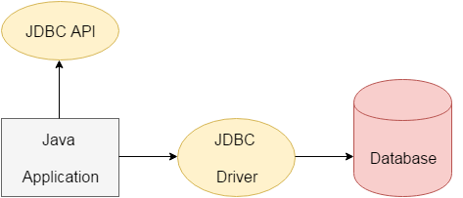
JDBC
The current version of JDBC is 4.3. It is the stable release since 21st September, 2017. It is based on the X/Open SQL Call Level Interface. The java.sql package contains classes and interfaces for JDBC API.

Slide 48
Interfaces of JDBC API
Driver interface
Connection interface
Statement interface
PreparedStatement interface
CallableStatement interface
ResultSet interface
ResultSetMetaData interface
DatabaseMetaData interface
RowSet interface

Slide 49
classes of JDBC API
DriverManager class
Blob class
Clob class
Before JDBC, ODBC API was the database API to connect and execute the query with the database. But, ODBC API uses ODBC driver which is written in C language (i.e. platform dependent and unsecured). That is why Java has defined its own API (JDBC API) that uses JDBC drivers (written in Java language).
We can use JDBC API to handle database using Java program and can perform the following activities:
Connect to the database
Execute queries and update statements to the database
Retrieve the result received from the database.

Slide 50
JDBC Driver
JDBC Driver is a software component that enables Java application to interact with the database.
There are 4 types of JDBC drivers:
JDBC-ODBC bridge driver
Native-API driver (partially java driver)
Network Protocol driver (fully java driver)
Thin driver (fully java driver)

Slide 51
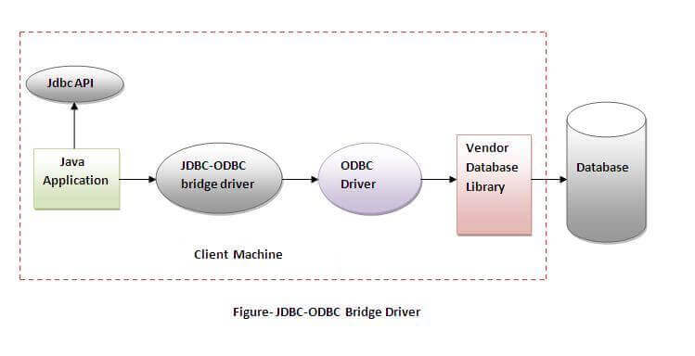
JDBC-ODBC bridge driver
The JDBC-ODBC bridge driver uses ODBC driver to connect to the database. The JDBC-ODBC bridge driver converts JDBC method calls into the ODBC function calls. This is now discouraged because of thin driver.
Advantages:
easy to use.
can be easily connected to any database.
Disadvantages:
Performance degraded because JDBC method call is converted into the ODBC function calls.
The ODBC driver needs to be installed on the client machine.

Slide 52
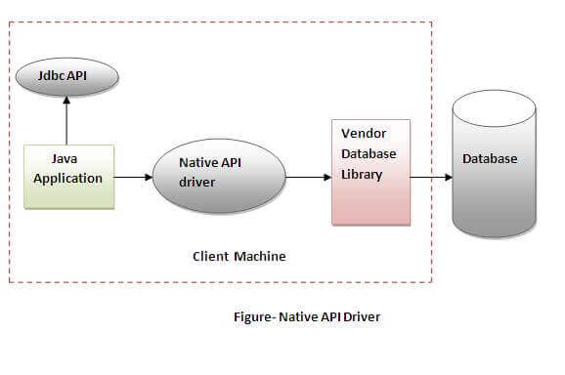
Native-API driver
The Native API driver uses the client-side libraries of the database. The driver converts JDBC method calls into native calls of the database API. It is not written entirely in java.
Advantage:
performance upgraded than JDBC-ODBC bridge driver.
Disadvantage:
The Native driver needs to be installed on the each client machine.
The Vendor client library needs to be installed on client machine.

Slide 53
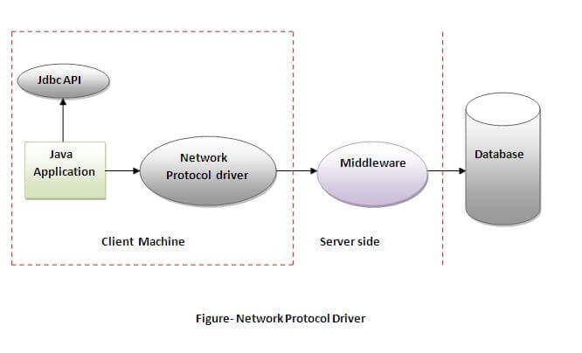
Network Protocol driver
The Network Protocol driver uses middleware (application server) that converts JDBC calls directly or indirectly into the vendor-specific database protocol. It is fully written in java.
Advantage:
No client side library is required because of application server that can perform many tasks like auditing, load balancing, logging etc.
Disadvantages:
Network support is required on client machine.
Requires database-specific coding to be done in the middle tier.
Maintenance of Network Protocol driver becomes costly, because it requires database-specific coding to be done in the middle tier.

Slide 54
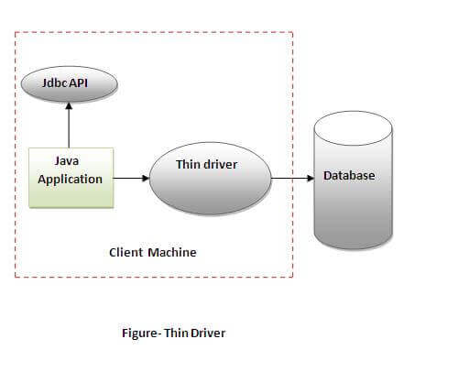
Thin driver
The thin driver converts JDBC calls directly into the vendor-specific database protocol. That is why it is known as thin driver. It is fully written in Java language.
Advantages:
Better performance than all other drivers.
No software is required at client side or server side.
Disadvantage:
Drivers depend on the Database.

Slide 55
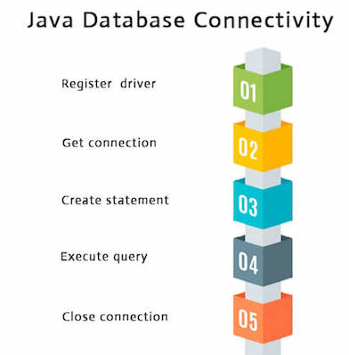
Database Connectivity with 5 Steps
There are 5 steps to connect any Java application with the database using JDBC. These steps are as follows:

Slide 56
1) Register the driver class
The forName() method of Class class is used to register the driver class. This method is used to dynamically load the driver Class. Syntax of forName() method
public static void forName(String className)throws ClassNotFoundException
Here, Java program is loading oracle driver to establish database connection.
Class.forName("oracle.jdbc.driver.OracleDriver");

Slide 57
2) Create the connection object
The getConnection() method of DriverManager class is used to establish connection with the database.
Syntax of getConnection() method
1) public static Connection getConnection (String url)throws SQLException
2) public static Connection getConnection (String url, String name, String password throws SQLException
Example to establish connection with the mysql database
Connection con = DriverManager.getConnection
("jdbc:mysql://localhost:3306/userinfo", "root", “password");

Slide 58
3) Create the Statement object
The createStatement() method of Connection interface is used to create statement. The object of statement is responsible to execute queries with the database.
Syntax of createStatement() method
public Statement createStatement()throws SQLException
Example to create the statement object
Statement stmt=con.createStatement();

Slide 59
4) Execute the query
The executeQuery() method of Statement interface is used to execute queries to the database. This method returns an object of ResultSet that can be used to get all the records of a table.
Syntax of executeQuery() method
public ResultSet executeQuery(String sql)throws SQLException
Example to execute query
ResultSet rs=stmt.executeQuery("select * from emp");
while(rs.next())
System.out.println(rs.getInt(1)+" "+rs.getString(2));

Slide 60
5) Close the connection object
By closing connection object statement and ResultSet will be closed automatically. The close() method of Connection interface is used to close the connection.
Syntax of close() method
public void close()throws SQLException
Example to close connection
con.close();

Slide 61
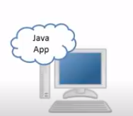
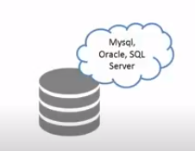
How both can communicate
JDBC
Programs/code
Data
1. Driver has to be ready
4. Execute the Query
3. Create Statement Object
2. Connection established
5. close the connection
Server
Clients
CRUD Queries
Runs at port
Different for different DBMS
3306 for MySql
No ports

Slide 62
Java Database Connectivity with Oracle
Driver class: The driver class for the oracle database is oracle.jdbc.driver.OracleDriver.
Connection URL: The connection URL for the oracle10G database is jdbc:oracle:thin:@localhost:1521:xe where jdbc is the API, oracle is the database, thin is the driver, localhost is the server name on which oracle is running, we may also use IP address, 1521 is the port number and XE is the Oracle service name.
Username: The default username for the oracle database is system.
Password: It is the password given by the user at the time of installing the oracle database.

Slide 63
Example
create table emp(id number(10),name varchar2(40),age number(3));
import java.sql.*;
class OracleCon{
public static void main(String args[]){
try{
//step1 load the driver class
Class.forName("oracle.jdbc.driver.OracleDriver");
//step2 create the connection object
Connection con=DriverManager.getConnection(
"jdbc:oracle:thin:@localhost:1521:xe","system","oracle");
//step3 create the statement object
Statement stmt=con.createStatement();
//step4 execute query
ResultSet rs=stmt.executeQuery("select * from emp");
while(rs.next())
System.out.println(rs.getInt(1)+" "+rs.getString(2)+" "+rs.getString(3));
//step5 close the connection object
con.close();
}catch(Exception e){ System.out.println(e);}
}
}

Slide 64
Statement interface to insert, update and delete the record.
import java.sql.*;
class FetchRecord{
public static void main(String args[])throws Exception{
Class.forName("oracle.jdbc.driver.OracleDriver");
Connection con=DriverManager.getConnection("jdbc:oracle:thin:@localhost:1521:xe","system","oracle");
Statement stmt=con.createStatement();
//stmt.executeUpdate("insert into emp765 values(33,'Irfan',50000)");
//int result=stmt.executeUpdate("update emp765 set name='Vimal',salary=10000 where id=33");
int result=stmt.executeUpdate("delete from emp765 where id=33");
System.out.println(result+" records affected");
con.close();
}}

Slide 65
ResultSet
Class.forName("oracle.jdbc.driver.OracleDriver");
Connection con=DriverManager.getConnection("jdbc:oracle:thin:@localhost:1521:xe","system","oracle");
Statement stmt=con.createStatement();
ResultSet rs=stmt.executeQuery("select * from emp765");
//getting the record of 3rd row
rs.absolute(3);
System.out.println(rs.getString(1)+" "+rs.getString(2)+" "+rs.getString(3));
con.close();
}}

Slide 66
PreparedStatement
import java.sql.*;
class InsertPrepared{
public static void main(String args[]){
try{
Class.forName("oracle.jdbc.driver.OracleDriver");
Connection con=DriverManager.getConnection("jdbc:oracle:thin:@localhost:1521:xe","system","oracle");
PreparedStatement stmt=con.prepareStatement("insert into Emp values(?,?)");
stmt.setInt(1,101);//1 specifies the first parameter in the query
stmt.setString(2,"Ratan");
int i=stmt.executeUpdate();
System.out.println(i+" records inserted");
con.close();
}catch(Exception e){ System.out.println(e);}
}
}

Slide 67
Contd..
PreparedStatement stmt=con.prepareStatement("delete from emp where id=?");
stmt.setInt(1,101);
int i=stmt.executeUpdate();
System.out.println(i+" records deleted");
PreparedStatement stmt=con.prepareStatement("select * from emp");
ResultSet rs=stmt.executeQuery();
while(rs.next()){
System.out.println(rs.getInt(1)+" "+rs.getString(2));
}

Slide 68
What is CallableStatement?
• Used to call Stored Procedures
• Supports IN, OUT, INOUT parameters
CallableStatement cs = con.prepareCall("{call procedure_name(?)}");

Slide 69
Stored Procedure Example
CREATE PROCEDURE getEmployeeByDept(IN dept_name VARCHAR(50))
BEGIN
SELECT * FROM employee WHERE department = dept_name;
END;

Slide 70
CallableStatement Example (IN)
CallableStatement cs = con.prepareCall("{call getEmployeeByDept(?)}");
cs.setString(1, "IT");
ResultSet rs = cs.executeQuery();

Slide 71
Stored Procedure with OUT Parameter
CREATE PROCEDURE countEmployees(OUT total INT)
BEGIN
SELECT COUNT(*) INTO total FROM employee;
END;

Slide 72
CallableStatement Example (OUT)
CallableStatement cs = con.prepareCall("{call countEmployees(?)}");
cs.registerOutParameter(1, Types.INTEGER);
cs.execute();
int total = cs.getInt(1);

Slide 73
PreparedStatement vs CallableStatement
PreparedStatement:
• Used for SQL Queries
• IN parameters only
CallableStatement:
• Used for Stored Procedures
• IN, OUT, INOUT parameters

Slide 74
Conclusion
• PreparedStatement improves security and performance
• CallableStatement executes stored procedures
• Both are widely used in real-time applications

Slide 75
ResultSetMetaData
import java.sql.*;
public class Rsmd{
public static void main(String args[]){
try{
Class.forName(“com.mysql.jdbc.Driver");
Connection con=DriverManager.getConnection(
"jdbc:mysql://@localhost:3306:EmployeeDB",“root",“root");
PreparedStatement ps=con.prepareStatement("select * from emp");
ResultSet rs=ps.executeQuery();
ResultSetMetaData rsmd=rs.getMetaData();
System.out.println("Total columns: "+rsmd.getColumnCount());
System.out.println("Column Name of 1st column: "+rsmd.getColumnName(1));
System.out.println("Column Type Name of 1st column: "+rsmd.getColumnTypeName(1));
con.close();
}catch(Exception e){ System.out.println(e);}
}
}

Slide 76
ResultSetMetaData
import java.sql.*;
public class Rsmd{
public static void main(String args[]){
try{
Class.forName("oracle.jdbc.driver.OracleDriver");
Connection con=DriverManager.getConnection(
"jdbc:oracle:thin:@localhost:1521:xe","system","oracle");
PreparedStatement ps=con.prepareStatement("select * from emp");
ResultSet rs=ps.executeQuery();
ResultSetMetaData rsmd=rs.getMetaData();
System.out.println("Total columns: "+rsmd.getColumnCount());
System.out.println("Column Name of 1st column: "+rsmd.getColumnName(1));
System.out.println("Column Type Name of 1st column: "+rsmd.getColumnTypeName(1));
con.close();
}catch(Exception e){ System.out.println(e);}
}
}

Slide 77
Other References
https://www.javatpoint.com/DatabaseMetaData-interface
https://www.javatpoint.com/storing-image-in-oracle-database
https://www.javatpoint.com/storing-image-in-oracle-database
https://www.javatpoint.com/storing-file-in-oracle-database
https://www.javatpoint.com/retrieving-file-from-oracle-database
https://www.javatpoint.com/CallableStatement-interface
https://www.javatpoint.com/transaction-management-in-jdbc
https://www.javatpoint.com/batch-processing-in-jdbc
https://www.javatpoint.com/jdbc-rowset

Slide 78
Oracle
To connect java application with the Oracle database ojdbc14.jar file is required to be loaded.
download the jar file ojdbc14.jar
Two ways to load the jar file:
paste the ojdbc14.jar file in jre/lib/ext folder
set classpath
1) paste the ojdbc14.jar file in JRE/lib/ext folder:
Firstly, search the ojdbc14.jar file then go to JRE/lib/ext folder and paste the jar file here.2) set classpath:
There are two ways to set the classpath:temporary
permanent
How to set the temporary classpath:
Firstly, search the ojdbc14.jar file then open command prompt and write:
C:>set classpath=c:\folder\ojdbc14.jar;.;
How to set the permanent classpath:
Go to environment variable then click on new tab. In variable name write classpath and in variable value paste the path to ojdbc14.jar by appending ojdbc14.jar;.; as C:\oraclexe\app\oracle\product\10.2.0\server\jdbc\lib\ojdbc14.jar;.;

Slide 79
Java Database Connectivity with MySQL
Driver class: The driver class for the mysql database is com.mysql.jdbc.Driver.
Connection URL: The connection URL for the mysql database is jdbc:mysql://localhost:3306/sonoo where jdbc is the API, mysql is the database, localhost is the server name on which mysql is running, we may also use IP address, 3306 is the port number and sonoo is the database name. We may use any database, in such case, we need to replace the sonoo with our database name.
Username: The default username for the mysql database is root.
Password: It is the password given by the user at the time of installing the mysql database. In this example, we are going to use root as the password.

Slide 80
MySQL
Let's first create a table in the mysql database, but before creating table, we need to create database first.
create database sonoo;
use sonoo;
create table emp(id int(10),name varchar(40),age int(3));

Slide 81
Example to Connect Java Application with mysql database
In this example, sonoo is the database name, root is the username and password both.
import java.sql.*;
class MysqlCon{
public static void main(String args[]){
try{
Class.forName("com.mysql.jdbc.Driver");
Connection con=DriverManager.getConnection(
"jdbc:mysql://localhost:3306/sonoo","root","root");
//here sonoo is database name, root is username and password
Statement stmt=con.createStatement();
ResultSet rs=stmt.executeQuery("select * from emp");
while(rs.next())
System.out.println(rs.getInt(1)+" "+rs.getString(2)+" "+rs.getString(3));
con.close();
}catch(Exception e){ System.out.println(e);}
}
}

Slide 82
Configuring
o connect java application with the mysql database, mysqlconnector.jar file is required to be loaded.
download the jar file mysql-connector.jar
Two ways to load the jar file:
Paste the mysqlconnector.jar file in jre/lib/ext folder
Set classpath
1) Paste the mysqlconnector.jar file in JRE/lib/ext folder:
Download the mysqlconnector.jar file. Go to jre/lib/ext folder and paste the jar file here.2) Set classpath:
There are two ways to set the classpath:temporary
permanent
How to set the temporary classpath
open command prompt and write:
C:>set classpath=c:\folder\mysql-connector-java-5.0.8-bin.jar;.;
How to set the permanent classpath
Go to environment variable then click on new tab. In variable name write classpath and in variable value paste the path to the mysqlconnector.jar file by appending mysqlconnector.jar;.; as C:\folder\mysql-connector-java-5.0.8-bin.jar;.;

Slide 83
Connectivity with Access without DSN
There are two ways to connect java application with the access database.
Without DSN (Data Source Name)
With DSN

Slide 84
Example to Connect Java Application with access without DSN
import java.sql.*;
class Test{
public static void main(String ar[]){
try{
String database="student.mdb";//Here database exists in the current directory
String url="jdbc:odbc:Driver={Microsoft Access Driver (*.mdb)};
DBQ=" + database + ";DriverID=22;READONLY=true";
Class.forName("sun.jdbc.odbc.JdbcOdbcDriver");
Connection c=DriverManager.getConnection(url);
Statement st=c.createStatement();
ResultSet rs=st.executeQuery("select * from login");
while(rs.next()){
System.out.println(rs.getString(1));
}
}catch(Exception ee){System.out.println(ee);}
}}

Slide 85
Example to Connect Java Application with access with DSN
import java.sql.*;
class Test{
public static void main(String ar[]){
try{
String url="jdbc:odbc:mydsn";
Class.forName("sun.jdbc.odbc.JdbcOdbcDriver");
Connection c=DriverManager.getConnection(url);
Statement st=c.createStatement();
ResultSet rs=st.executeQuery("select * from login");
while(rs.next()){
System.out.println(rs.getString(1));
}
}catch(Exception ee){System.out.println(ee);}
}}

